Slide 2
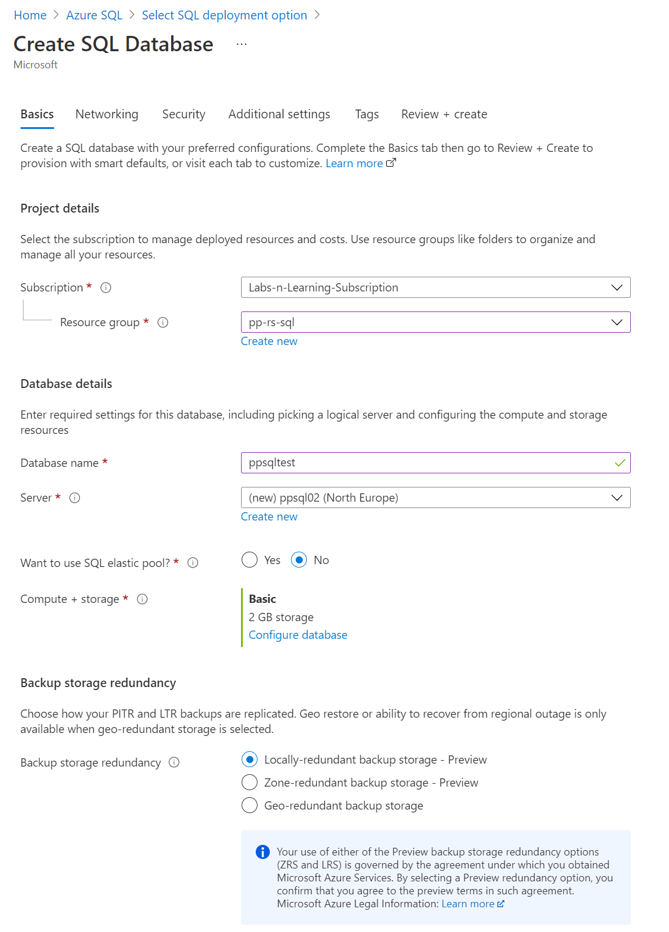
Notes:
Create Server
Add Firewall Rule
Test connection in SSMS – worked

Slide 3
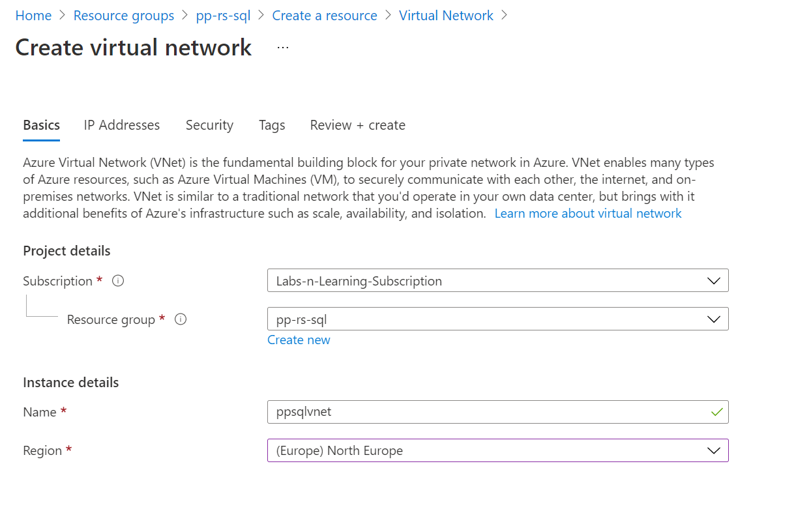
Create VNET

Slide 4
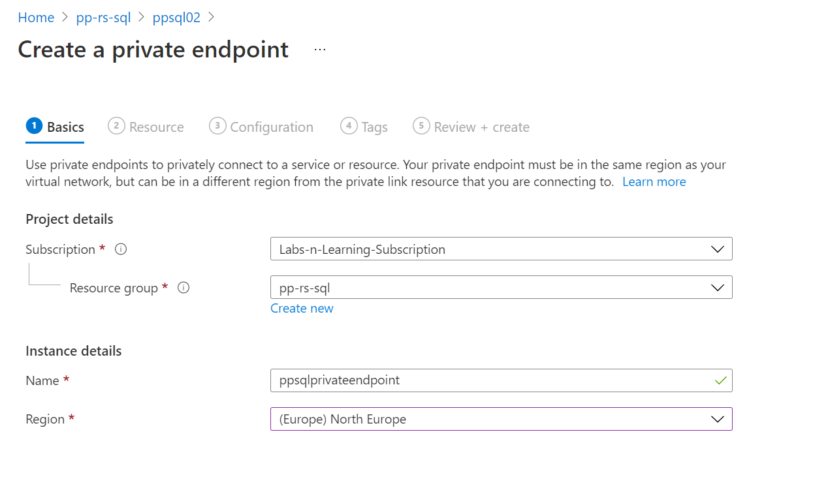
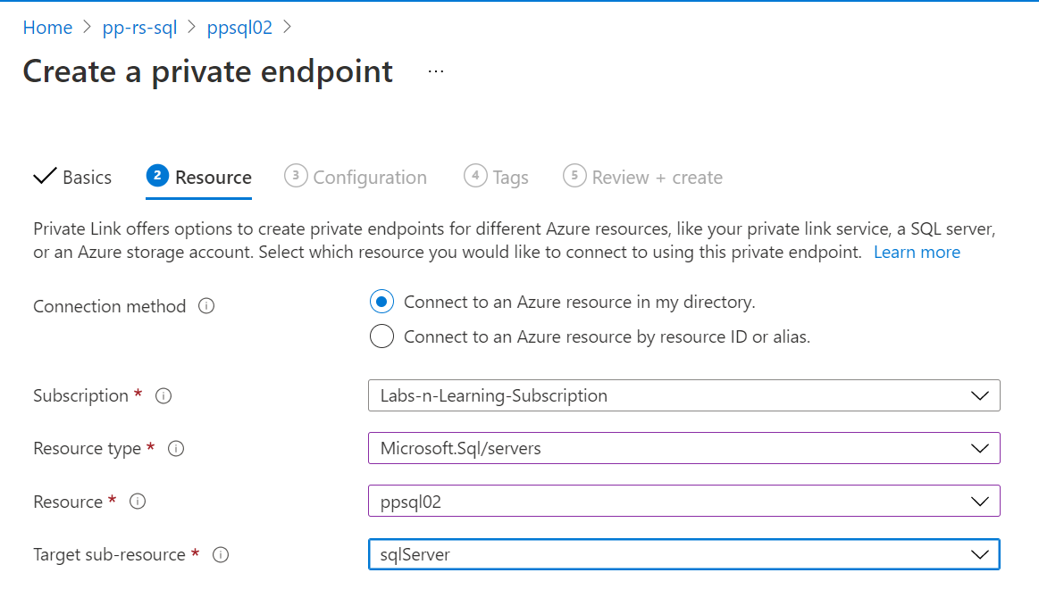
Create Private Endpoint

Slide 5
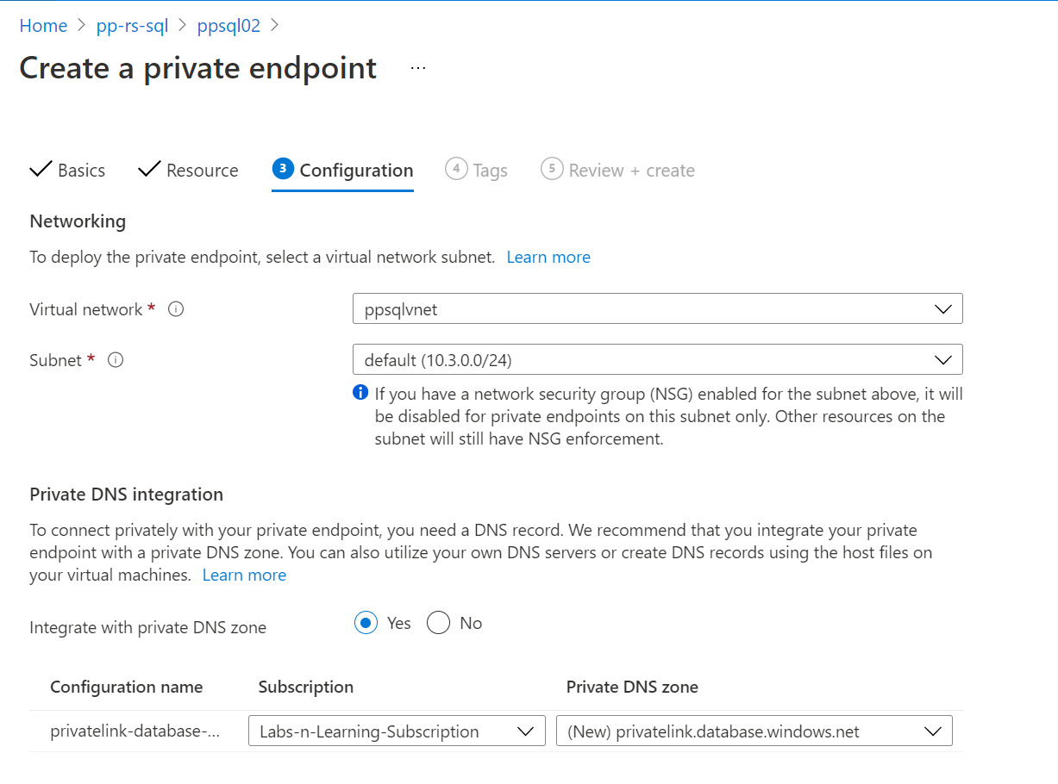

Slide 6
Create new VM on the same VNet

